Slide 1

Decoding Natures Final Project Proposal
Maya Lee

Slide 2
Project Background
(NYUAD) is a diverse community = new discussions and ideas made and gone every day
So, it’s hard to keep track of these ideas and opinions
In this project, we throw different key words around long lasting or rising social issues or and allow the NYUAD student body to input words and concepts that come to their mind
With this, we will be able to draw a mind map of the whole population’s thought, helping us realize and understand where we, as a whole, are standing

Slide 3
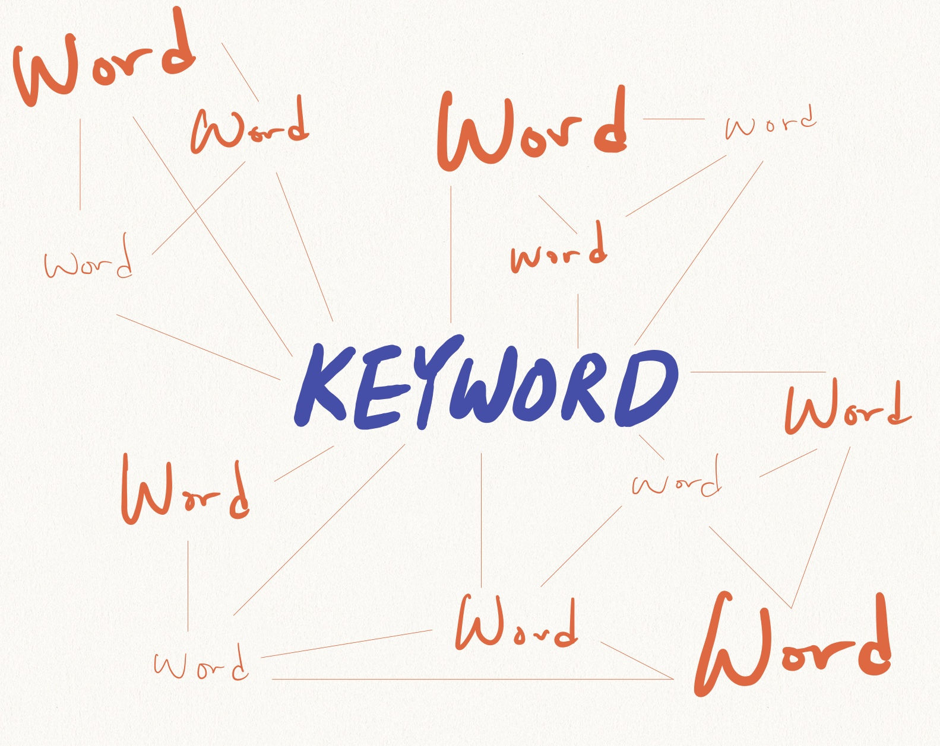
Project Description
A display screen will show a mind map of different words, which will be portrayed by floating texts connected with lines
With the keyword displayed at the middle of the screen, the users will be able to input one word that comes to their mind related to the keyword

Slide 4
Project Description
When the input word is given for the first time, it will appear on the screen with a smaller font
If an input word is mentioned again and again by other users, the size of the words will get bigger, making it more and more visible
So, users of this project will be able to see how rest of the student body thinks about different topics

Slide 5
Project Technology and Implementation
The main screen will display a keyword in the middle of the screen
User will be able to give a single word that comes to their mind when they see the keyword in the middle of the screen
These keywords will be refreshed every 3 minutes. After 3 minutes, the user will meet another keyword.
There will be buttons or links to allow users to switch to another keyword if they wish to, even if it hasn’t been 3 minutes

Slide 6
Expected Challenges
May need Mutliple html links (for each keyword) = method still under consideration
Need to consider how to handle inputs
Will it generate on its own if we lack inputs?
If we have overflowing amount of input, will it delete everything and restart?

Slide 7
Thank you
If there are any feedbacks or ideas, please let me know.
I would appreciate it.

